Slide 1



Digit Recognition with CNNs
This project explores the power of Convolutional Neural Networks (CNNs) for building a digit recognition system. Using the MNIST dataset, we will delve into the process of training and evaluating a CNN model for accurate digit classification.

Slide 2
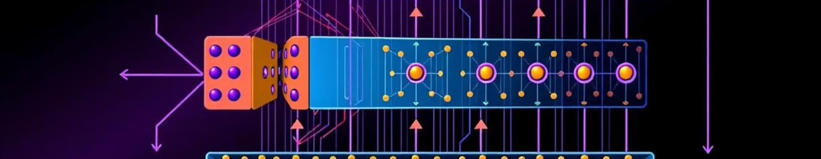
Convolutional Neural Networks (CNNs)
CNNs are a specialized type of neural network designed for image processing tasks. They excel at recognizing patterns in images due to their convolutional layers, which extract features and reduce data dimensionality.
1
Feature Extraction
2
Pooling Layers
3
Fully Connected Layers
Convolutional layers use filters to identify features like edges, corners, and textures in images.
Pooling layers downsample the feature maps, reducing their size while retaining important information.
These layers learn complex relationships between features and produce the final classification output.

Slide 3
The MNIST Dataset
The MNIST dataset contains a large collection of handwritten digits, each labeled with its corresponding value. This dataset is widely used for training and evaluating image classification models, providing a benchmark for digit recognition tasks.
Training Data
Image Size
Class Labels
The dataset is split into training and testing sets, allowing for model evaluation after training.
Each image in MNIST is a grayscale image with a resolution of 28x28 pixels.
Each image is labeled with a corresponding digit, ranging from 0 to 9.

Slide 4
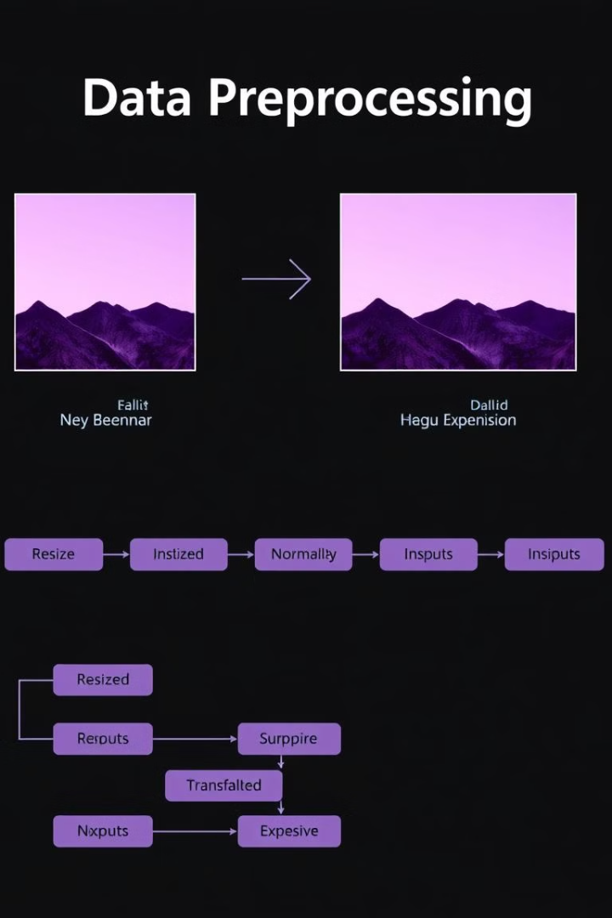
Data Preprocessing and Augmentation
Before training a CNN, it is crucial to preprocess the data to improve the model's performance. This involves scaling image values, augmenting data for diversity, and preparing the data for training.
1
Scaling
Normalize image pixel values to a range between 0 and 1, improving training stability.
2
Data Augmentation
Introduce variations to the training data, such as rotations and shifts, to make the model more robust.
3
Batching
Divide the training data into batches to efficiently feed the model during training.

Slide 5
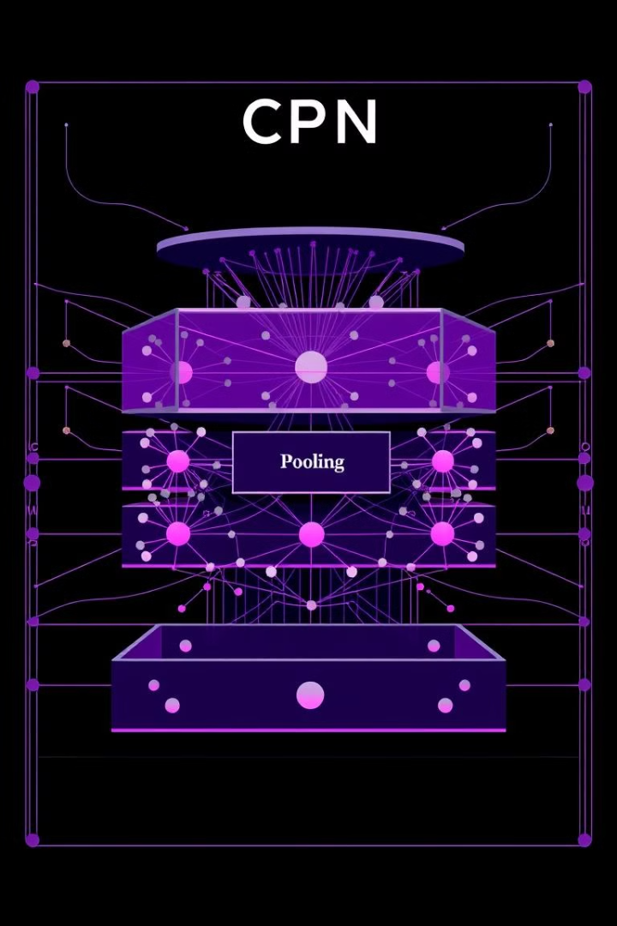
CNN Architecture Design
The architecture of a CNN plays a critical role in its performance. It dictates the number of layers, the filter size, and the activation functions used, ultimately influencing the model's ability to learn features and make accurate predictions.
Layer Type
Function
Parameters
Convolutional
Feature extraction
Filter size, stride, activation function
Pooling
Downsampling
Pooling size, stride
Fully Connected
Classification
Number of neurons, activation function

Slide 6
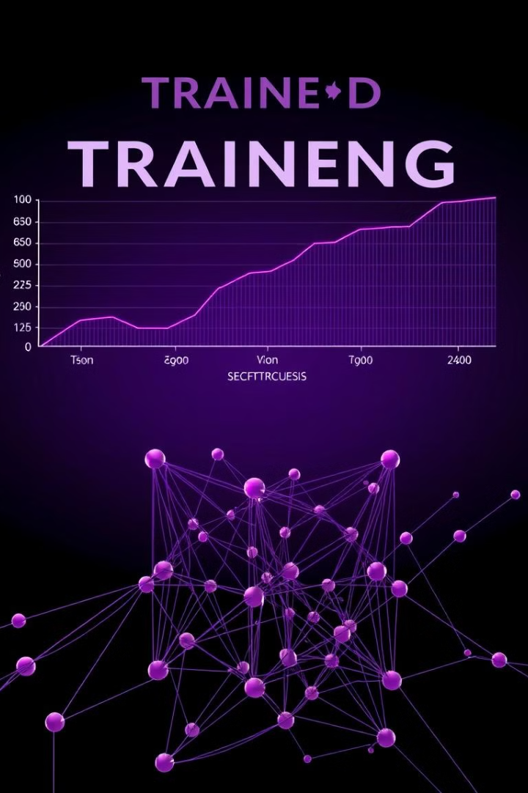




Model Training and Optimization
The process of training a CNN involves feeding the model training data and iteratively adjusting its weights to minimize the error between its predictions and the actual labels. Optimization algorithms are used to guide this adjustment process.
Forward Pass
The model processes the input data through its layers to generate predictions.
Loss Calculation
The difference between the predictions and true labels is calculated as the loss.
Backpropagation
The loss is propagated back through the network to update the weights.
Weight Update
The weights are adjusted according to the optimization algorithm to minimize the loss.

Slide 7
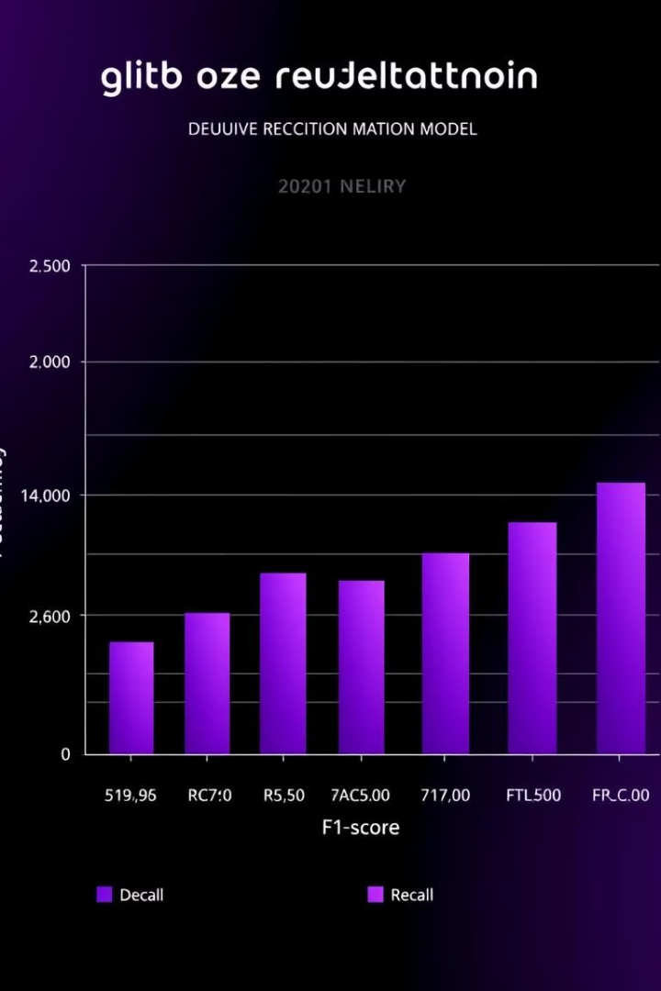
Evaluation and Performance Metrics
After training, the model's performance must be evaluated using appropriate metrics to assess its accuracy and generalization ability. Metrics like accuracy, precision, recall, and F1-score are used to gauge the model's effectiveness in classifying digits correctly.
Accuracy
Precision
The proportion of correctly classified digits to the total number of digits.
The proportion of correctly classified digits among those predicted as a specific digit.
Recall
F1-score
The proportion of correctly classified digits among all instances of a specific digit.
A harmonic mean of precision and recall, providing a balanced measure of performance.

Slide 8




Conclusion and Future Directions
The digit recognition system developed in this project demonstrates the potential of CNNs for solving complex image processing tasks. Future work could involve exploring more complex architectures, experimenting with different optimization strategies, and applying the model to real-world scenarios.
Improved Architectures
Exploring deeper networks or incorporating residual connections for improved performance.
Larger Datasets
Training on larger and more diverse datasets to enhance the model's generalization ability.
Real-World Applications
Deploying the model for practical uses like document processing, character recognition, or image analysis.

